Slide 1
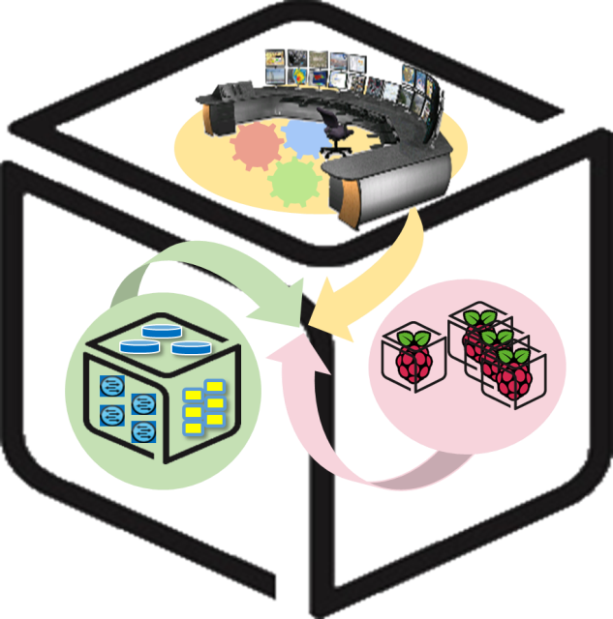



Computer Systems
For AI-inspired Cloud
Theory & Lab.
Lab #3: Tower
https://github.com/SmartX-Labs/SmartX-Mini-MOOC

Slide 2


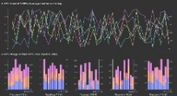





Tower Lab: Concept
Control Tower
Orchestration
Center
Provisioning
Center
Intelligence
Center
Visibility
Center
Docker Runtime
Linux Ubuntu OS

Slide 3

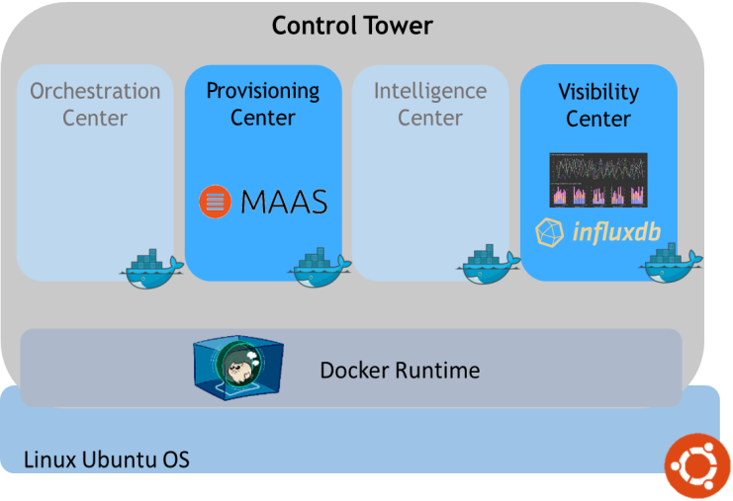


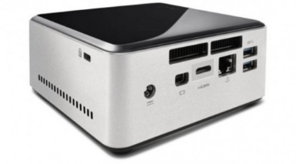



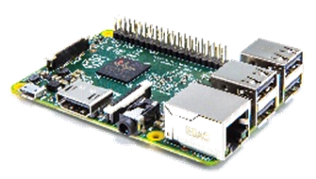



SmartX Labs #1~#3: Relationship
Tower Lab
Kafka broker cluster
Box Lab
VM
Tap1
br0
em1
Inter-Connect Lab
Hypriot OS

Slide 4



Theory

Slide 5
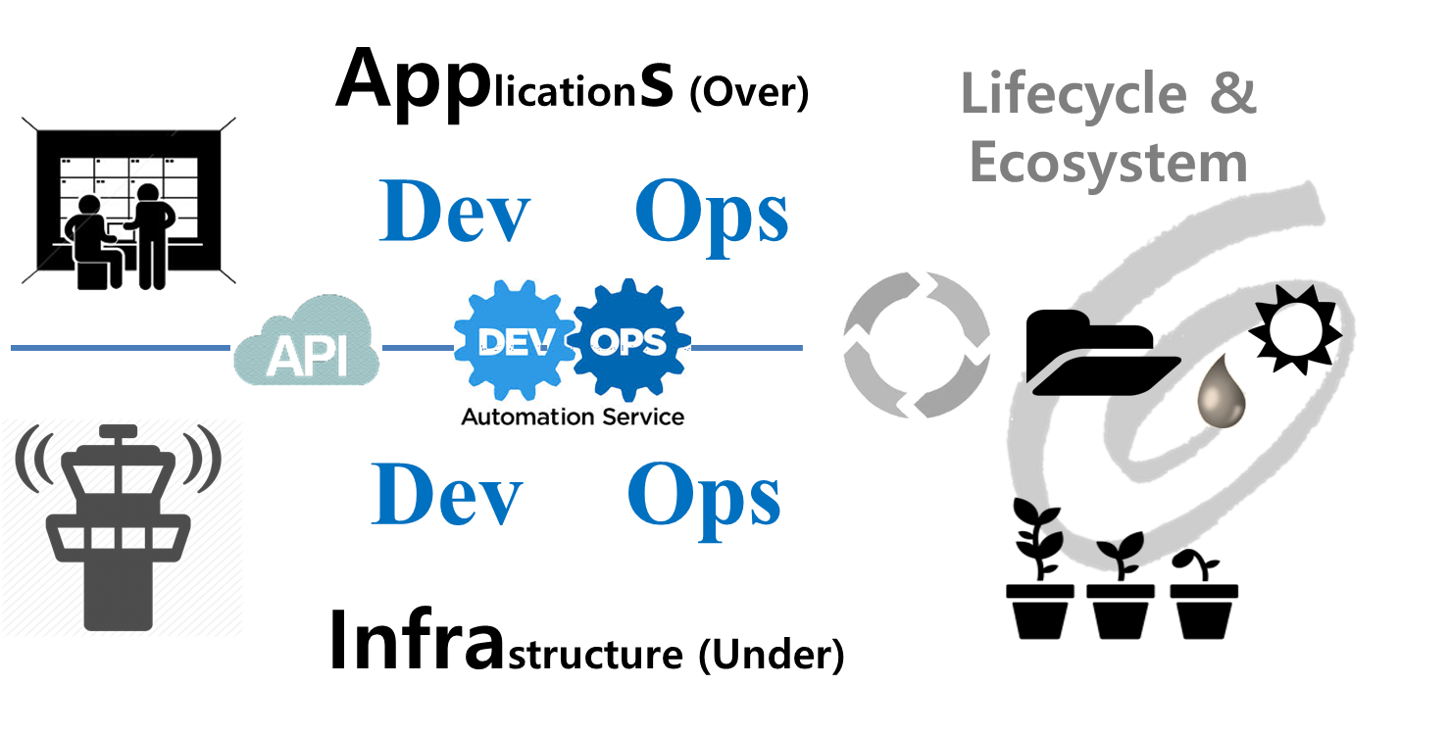
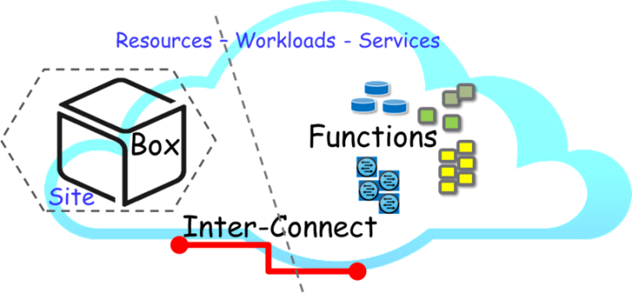
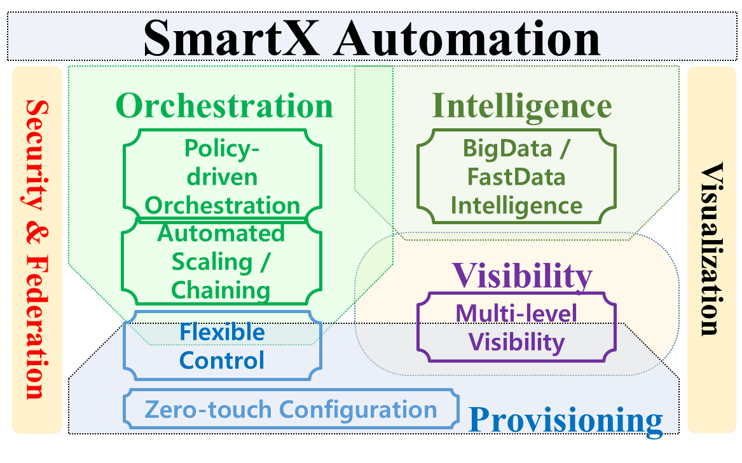
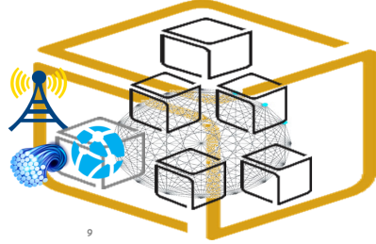
SmartX Automation Framework

Slide 6

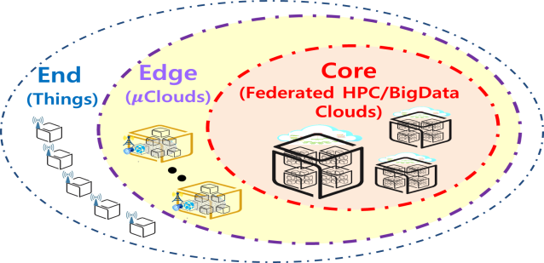






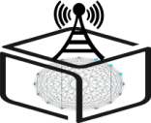

SmartX Composable Playground & Boxes
Type B/C
SmartX
Cloud Box
Type O
Type K/S
SmartX
DevOps Tower Cloud
with DataLake
SmartX
Edge μBoxes
SmartX
Edge Cluster
End
Edge
Core
Things
$μ$Clouds (SDN/NFV)
Clouds (HPC/BigData)

Slide 7
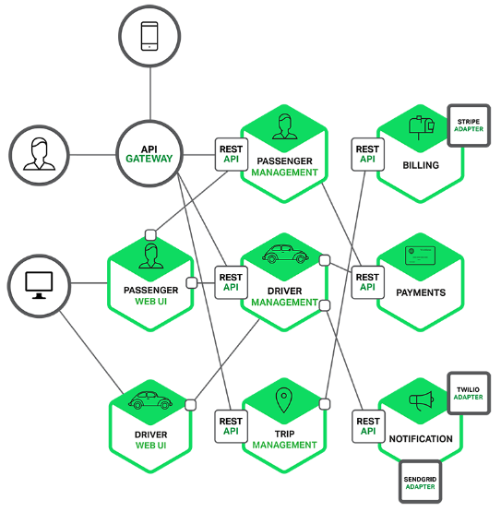
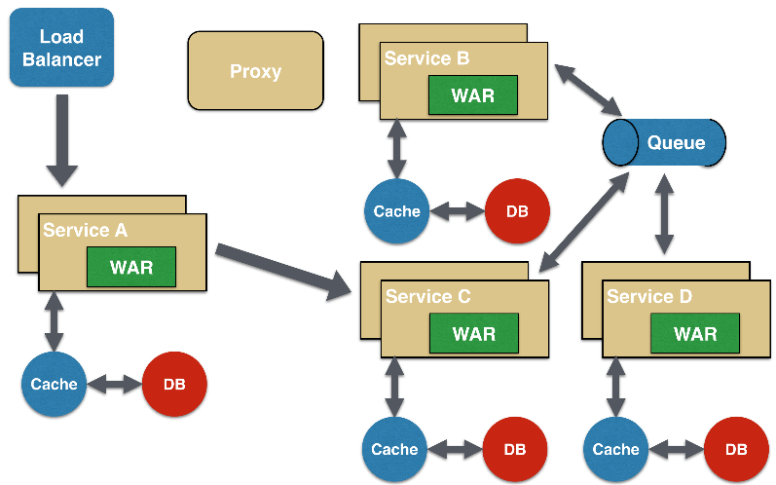
Container-based MSA (MicroServices Architecture)
Software development technique based on Collection of loosely coupled small-size services (i.e., functions)
Fine-grained services and lightweight protocols to improve modularity, create applications easier, and helps resiliency against architecture erosion

Slide 8



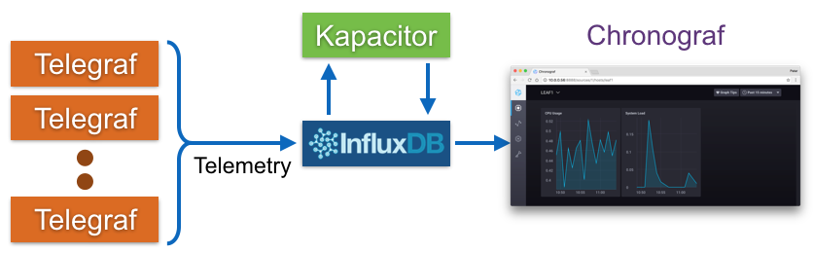
Visibility: TSDB (Time Series Database)
Time series data is arrays of numbers indexed by time.
In some fields these time series are called profiles, curves, or traces.

Slide 9

Visibility: Zabbix Distributed Monitoring
Adopts a flexible notification mechanism
User can configure & watch graph easily via Web GUI
Consists of structured server and client
Client collects the monitoring data and send it to the Zabbix server
Server visualizes the data that is collected by the Zabbix Agent
Zabbix Server Agent structure

Slide 10
Ubuntu boot procedure
Ubuntu boot up phases
1. BIOS
2. Boot loader
▶ When the computer begins execution, it starts by executing the firmware, and obtain the boot loader.
▶ The job of the boot loader is to begin the next phase, loading the kernel and an initial ram disk filesystem.
3. Kernel
4. Upstart
X
▶ The kernel launches the init script inside the initrd file system, which loads hardware drivers and finds the root partition.
▶ After the kernel is running, the remainder of the operating system is brought online.
Reference: https://wiki.ubuntu.com/Booting

Slide 11






Remote OS installation on machines
Remote OS installation targets
Bare metal
Mobile device
OS absent in the hardware
For remote OS installation, the host doesn't have a decision-making power.
OS already activated in the hardware
From the standpoint of user, OS is installed automatically by host.
MAAS(Metal As A Service) is better suited to the bare metal.

Slide 12
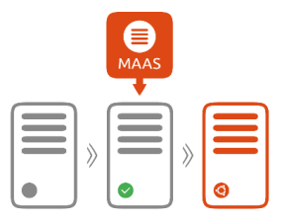
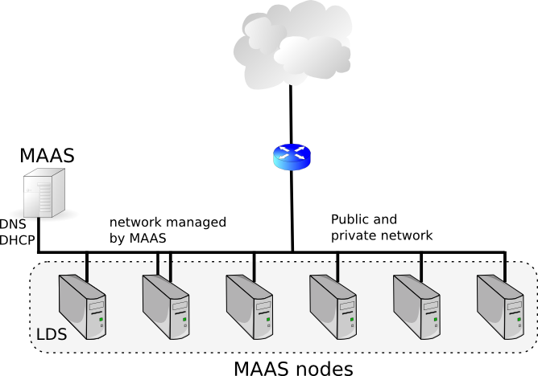
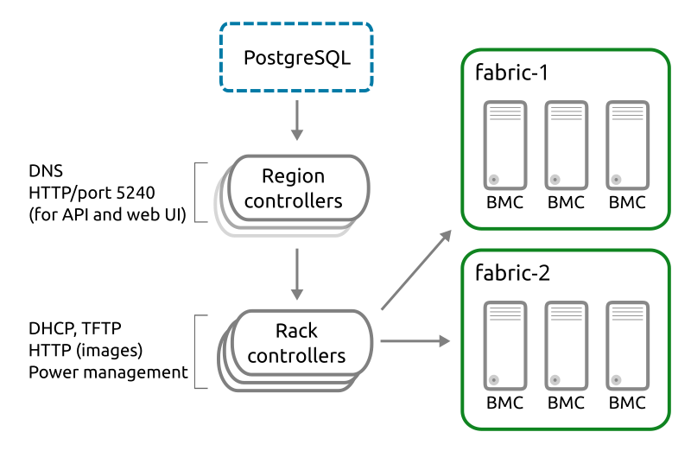
Provisioning: Ubuntu MAAS (Metal as a Service)
Bear-metal machines can be quickly provisioned and destroyed; MAAS provides management of a large number of physical machines by creating a single resource pool
MAAS can act as a standalone PXE services, provides Web GUI, supports various Linux distribution installation, …
MAAS Controller Architecture
Region Controller: Deals with operator requests
Rack Controller: Provide the high bandwidth services to multiple server racks + Cache OS install images
Reference: https://docs.maas.io/2.4/en/intro-concepts#controllers

Slide 13

MAAS: OS Automated Installation
Manual Installation
Automatic Installation
2
MAAS
Rack Controller
MAAS
Region Controller
Installation
Triggering
Reboot Manually
IPMI Based
Power Management
1
DHCP
Operator
Prepare Install CD/USB
Choose CD/USB Boot
3
PXE Booting
TFTP
Operator
WEB
Answer each questions manually
(partitions, interfaces, etc...)
4
OS Installation
Process
Configure the box after installation (NIC, Account, etc.)
5
OS Configuration
Process
Warning!
Box Hardware Requirements for Automated Installation
*IPMI, Intel AMT, IBM HMC, …
PXE bootable with DHCP option
Two Ethernet interfaces
*IPMI: The intelligent Platform Management Interface. Remote hardware health monitoring and management system that defines the interfaces for use in monitoring

Slide 14



MAAS: Remote OS installation process
Remote OS installation Process
DHCP server contacted
Kernel, initrd received over TFTP
Machine boots
Initrd mounts a squashfs image over HTTP
Enlistment
Commissioning
Deployment
5. cloud-init runs enlistment scripts
6. Machine shuts down
5. cloud-init runs commissioning scripts
6. Machine shuts down
5. cloud-init triggers deployment
Curtin installation script run
Squashfs image placed on disk

Slide 15
Practice

Slide 16
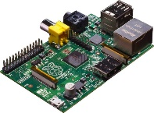
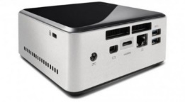


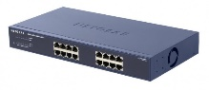
NAME: NUC5i5MYHE (NUC PC) CPU: i5-5300U @2.30GHz CORE: 4 Memory: 16GB DDR3 HDD: 94GB
#0 Lab Preparation (1/2)
Wired connection
NAME: Raspberry Pi Model B (Pi) CPU: ARM Cortex A7 @900MHz CORE: 4 Memory: 1GB SD Card: 32GB
NAME: NT900X3A
CPU: i5-2537U @1.40GHz
CORE: 2 Memory: 4GB DDR3 HDD: 128GB
NAME: netgear prosafe 16 port gigabit switch(Switch) Network Ports: 16 auto-sensing 10/100/1000 Mbps Ethernet ports

Slide 17
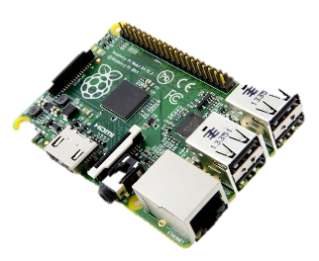









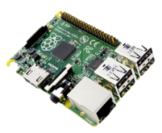
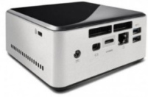
#0 Lab Preparation (2/2)
Verify Inter-Connect Lab’s configuration
Kafka broker cluster
Hypriot OS
Hypriot OS
Ubuntu Linux
Are they working?
If you can see logs of resource status on console consumer, go ahead!

Slide 18
Visualization of Resource Visibility
Control Tower
Orchestration
Center
Provisioning
Center
Intelligence
Center
Visibility
Center
Docker Runtime
Linux Ubuntu OS

Slide 19
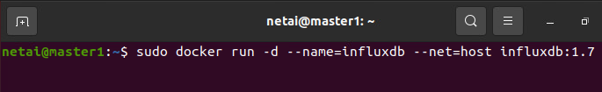
#1 Run InfluxDB & Chronograf Containers on NUC
Run InfluxDB Container
$ sudo docker run -d --name=influxdb --net=host influxdb:1.7
Make and run Chronograf container
$ sudo docker run -p 8888:8888 --net=host chronograf --influxdb-url=http://<NUC IP>:8086
Type without a space!

Slide 20
#2 Install python packages:for python Kafka consumer
Install python-pip
$ sudo apt-get install -y libcurl3 openssl curl
$ sudo apt-get install -y python2.7 python-pip
$ sudo apt-get install -y python3-pip
Install python package
$ sudo pip install requests
$ sudo pip install kafka-python
$ sudo pip install influxdb
$ sudo pip install msgpack

Slide 21
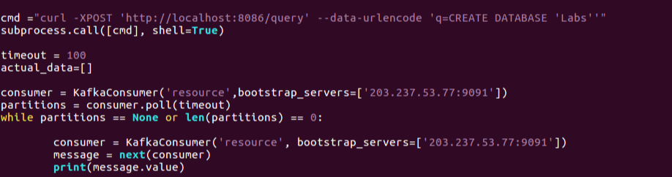
#3 Broker to InfluxDB code:Modify & Run python code
Open ‘broker_to_influxdb.py’ code
$ vi ~/SmartX-mini/ubuntu-kafkatodb/broker_to_influxdb.py
Run python code
$ sudo sysctl -w fs.file-max=100000
$ ulimit -S -n 2048
$ python ~/SmartX-mini/ubuntu-kafkatodb/broker_to_influxdb.py
Modify to your nuc IP Address
Modify to your nuc IP Address

Slide 22

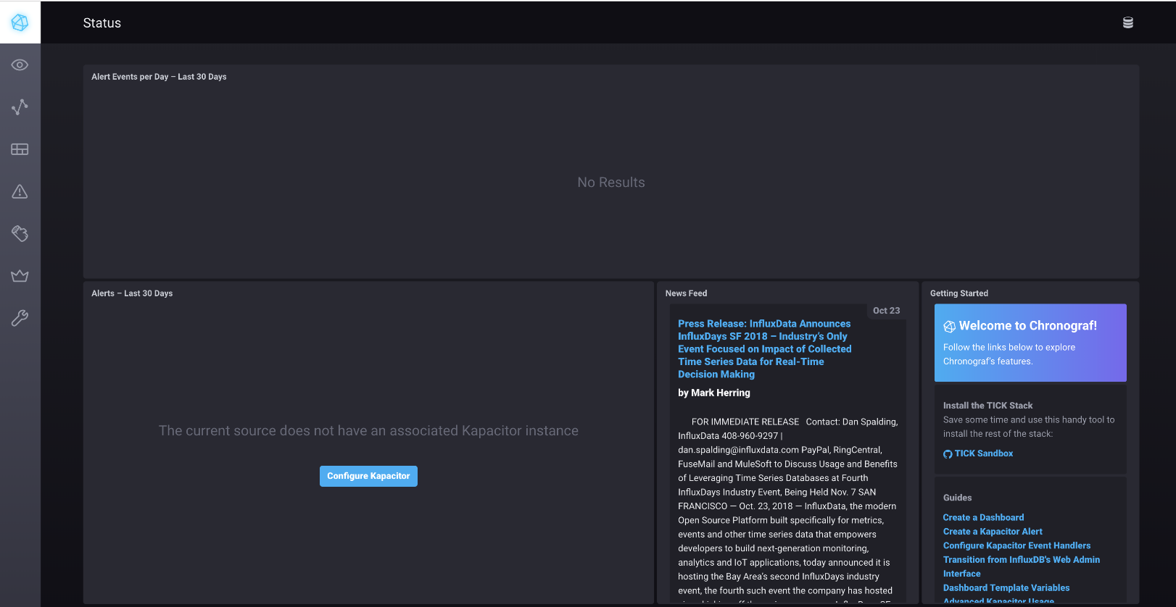
#4 Configure Chronograf Dashboard (1/4)
Open Web browser and connect to Chronograf Dashboard
http://<NUC IP>:8888

Slide 23
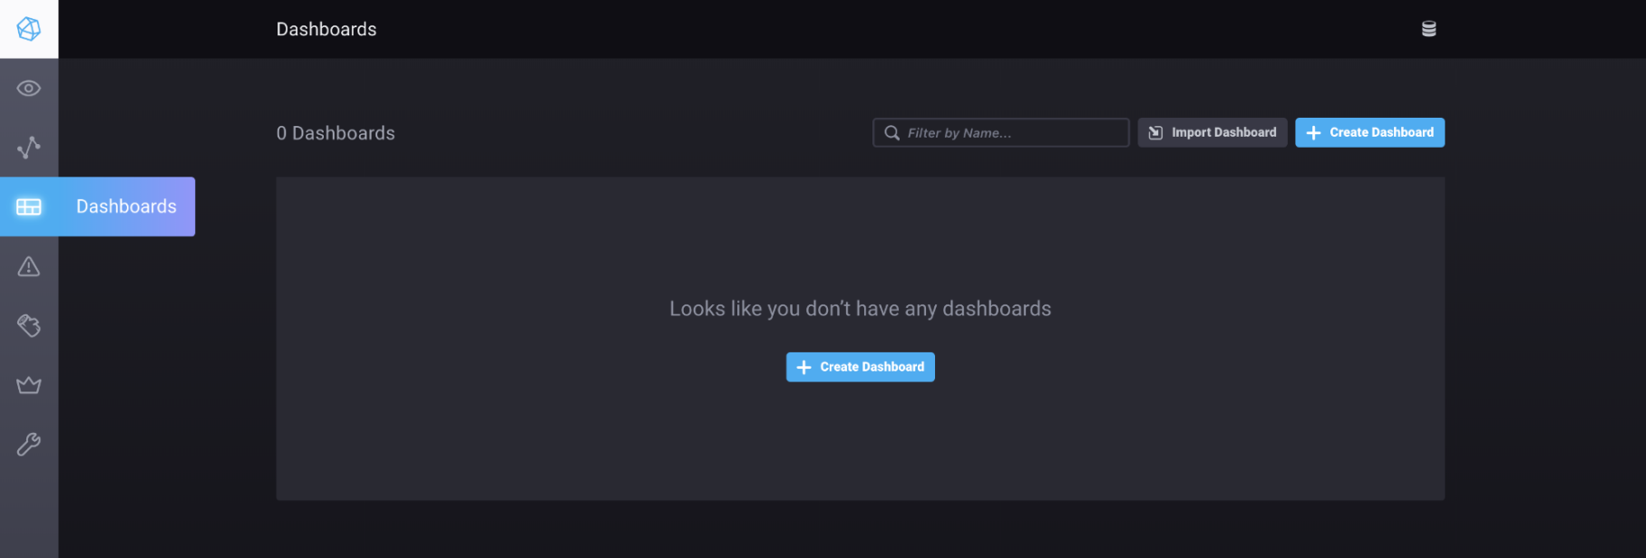
#4 Configure Chronograf Dashboard (2/4)
Create Dash board

Slide 24
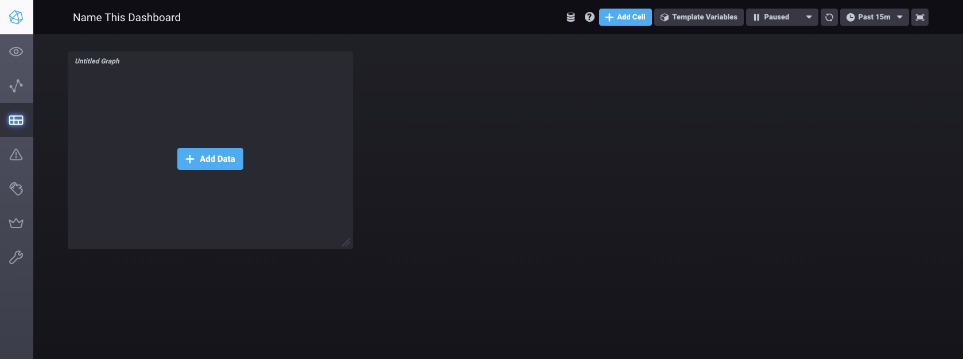
#4 Configure Chronograf Dashboard (3/4)
Add Cell & Data

Slide 25
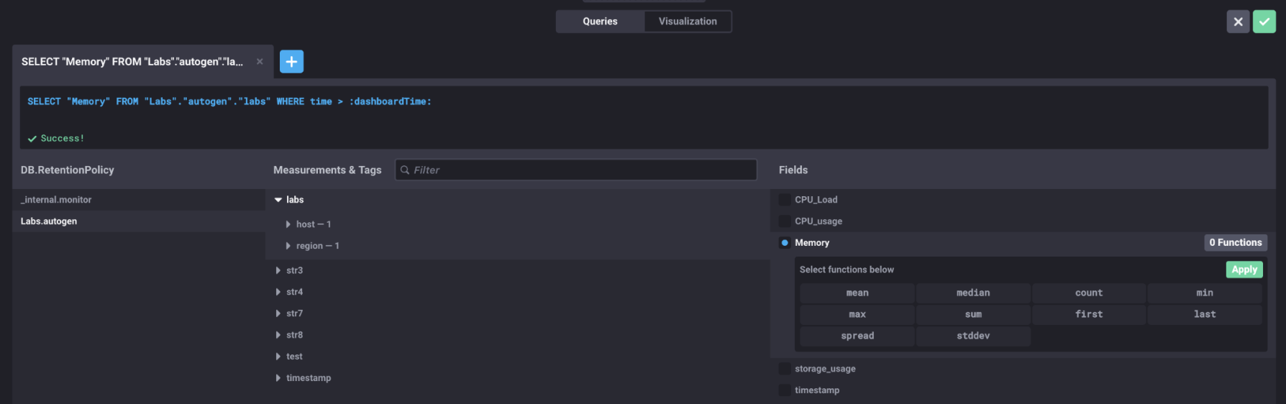
#4 Configure Chronograf Dashboard (4/4)
Add Data

Slide 26
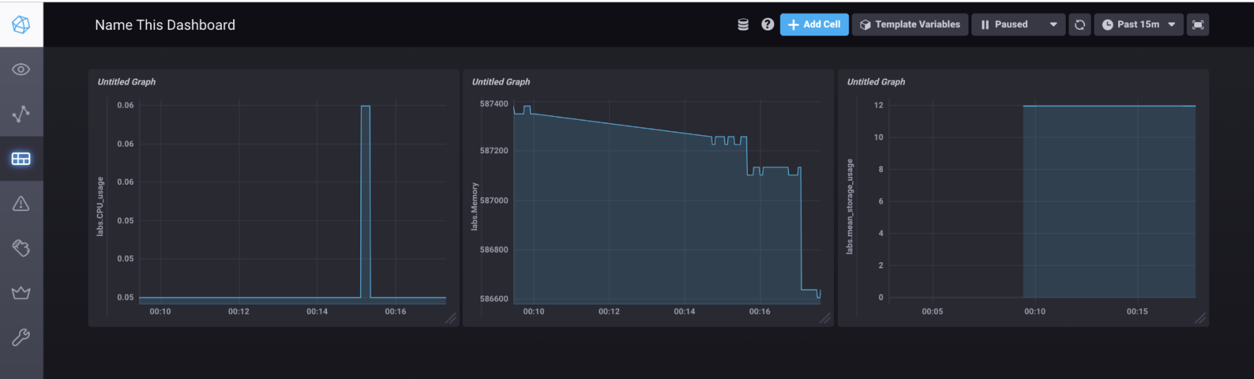
#5 – Check Chronograf Dashboard
We can see the changes of values from database

Slide 27
Automated Provisioning & Visibility
Control Tower
Orchestration
Center
Provisioning
Center
Intelligence
Center
Visibility
Center
Docker Runtime
Linux Ubuntu OS

Slide 28
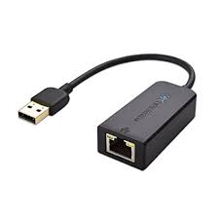
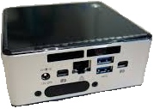
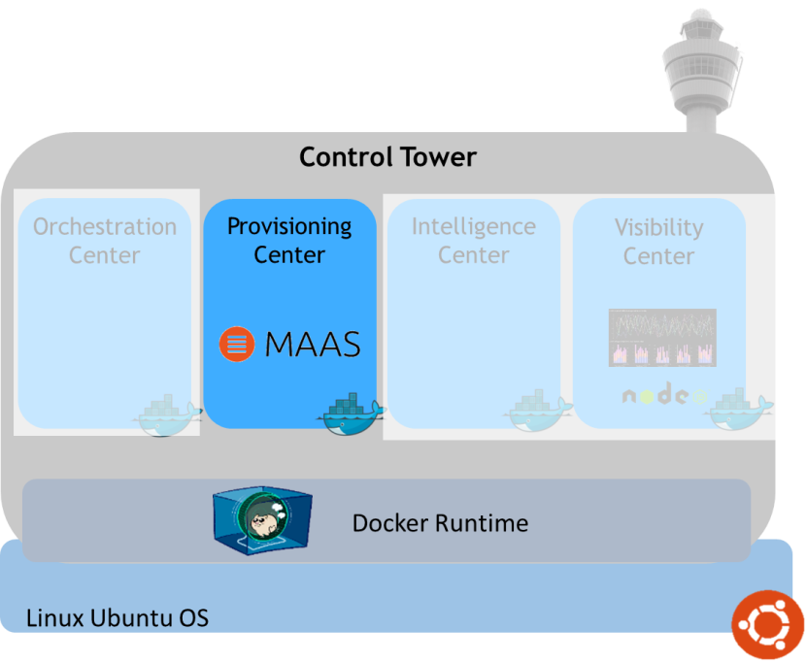
#6–1 OS manual Installation: Establish physical interconnect
Management & Control
Any Ethernet port
that support PXE
Requirements for manual Installation
DHCP PXE bootable
USB to ethernet connector
Note: Typical NUC does not have a IPMI port.

Slide 29
#6-2 Install MAAS server
From target NUC, go to BIOS, turn on PXE and set network boot priority
NUC reboot (to apply BIOS changes)
Install MAAS server
$ sudo apt update
$ sudo apt install maas
Initiate MAAS server
$ sudo maas init
Login to the MAAS UI at:
http://<your.maas.ip>:5240/MAAS
From the MAAS UI, you need to make user configurations
*Region name
Ubuntu images
Turn on DHCP
Go to the “Subnets” tab, select the VLAN for which you want to enable DHCP
From the “Take action” button select “Provide DHCP”
*region : Organizational unit. Contains all information about all machines running

Slide 30
#6-3 Enlist, Commission and deploy the box
Enlist the NUC
Set all the servers to PXE boot
NUC reboot (When hardware is initialized, all software operations stop)
Check the NUC appear in MAAS
If the NUC does not support IPMI based BMC, edit them and enter their BMC details
Commission the NUC
Go to “machine interface”, “configuration” and set “power type” to “manual”
From the “take action” button, select “commission”
NUC reboot (When a new kernel is installed, the box must be rebooted as to prevent the removed kernel from being loaded which will halt the NUC operation)
Deploy the NUC
From the “take action” button, choose ”deploy” and click “view this page”
From SSH keys, choose source and click upload
Set “id_rsa.pub” as a public key and click “import”

Slide 31
#6-4 Deploying the box
Create SSH key
$ sudo ssh-keygen
$ sudo cat ~/.ssh/id_rsa.pub
Copy the outcome , press “upload” and paste it on “User ID” and import
Deploy
From “take action”, choose “deploy”
OS remote Install complete

Slide 32
Appendix
Remaining Lab practice requires
special Box resources with
IPMI or similar Remote Power Management, PXE Boot support

Slide 33
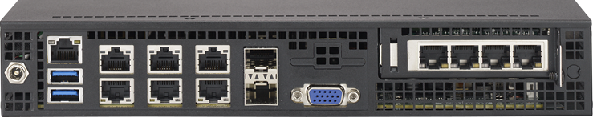
#7–1 OS Automated Installation: Establish physical interconnect
Power
Management & Control
IPMI port
Any Ethernet port
that support PXE
Requirements for Automated Installation
IPMI, Intel AMT, IBM HMC … and so on.
DHCP PXE bootable
Note: Typical NUC does not satisfy the above requirement!

Slide 34

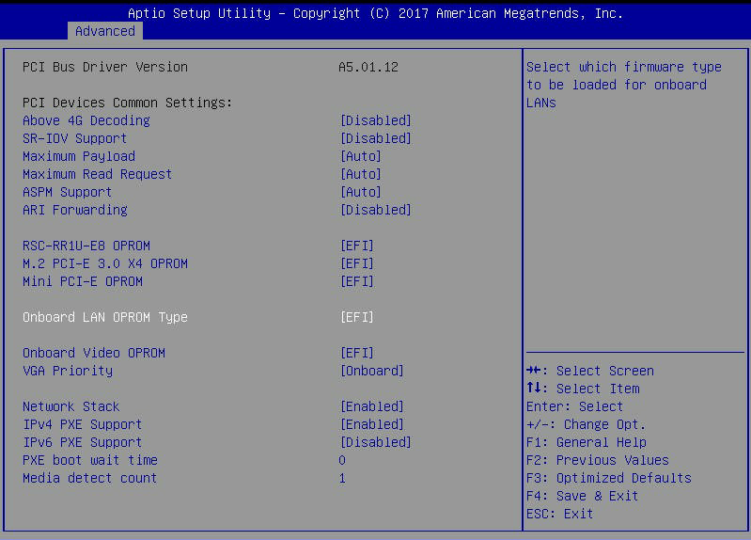
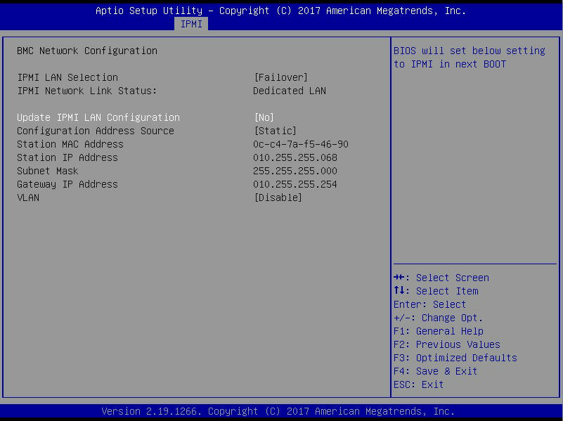
#7–2 OS Automatic Installation: BIOS Configuration
IPMI IP Configuration
<BIOS PXE Configuration>
<BIOS IPMI Configuration>
After then Save Configuration and Exit
And then the PXE booting sequence is stated

Slide 35
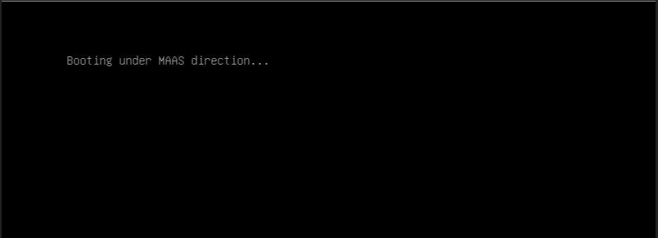
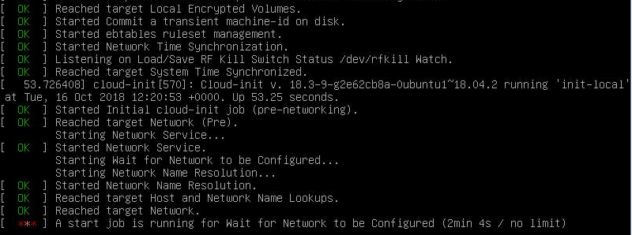
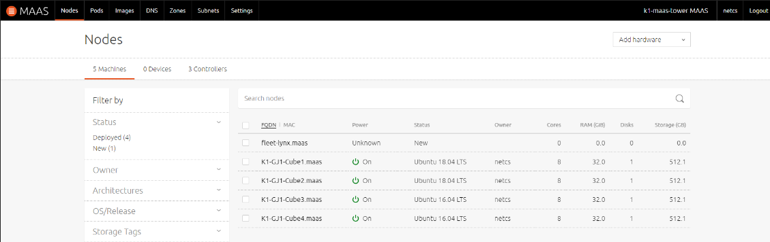
#8–1 OS Automatic Installation:Enlistment
Check this message
<Succeed PXE booting>
<Enlistment after PXE booting>
<After Enlistment (you can check on Web GUI) >

Slide 36
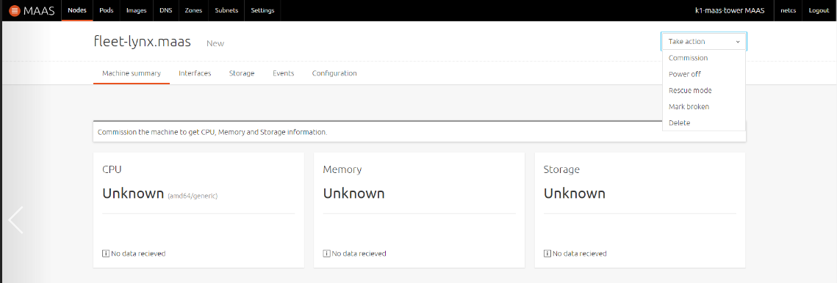
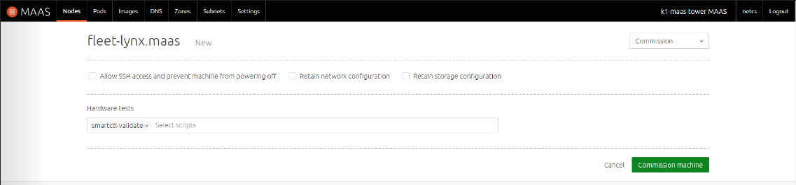
#8–2 OS Automatic Installation:Commissioning
Click this button to commission
All the hardware information
shown as ‘Unknown’ before
Commissioning
Do not check anything
Click this button to commission
It takes about 10 minutes

Slide 37
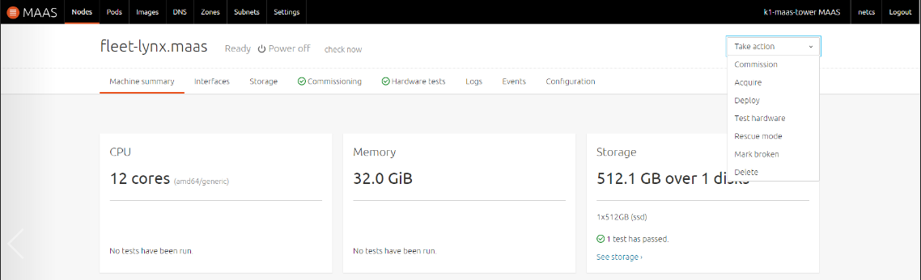
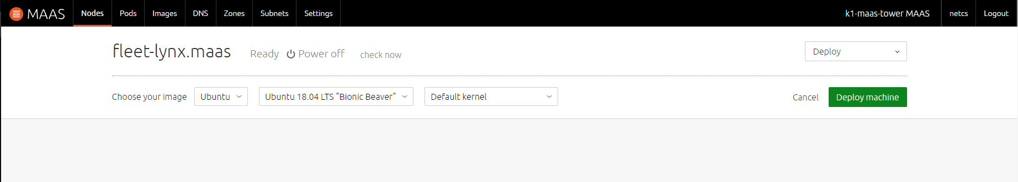
#8–3 OS Automatic Installation:Deployment (1/2)
You can see Ready state
and power on/off state
after commissioning
Click this button to Deploy
You can see all the Hardware information
After commissioning
Click this button to Deploy
It is a OS Installation procedure
It takes about 15 minutes

Slide 38
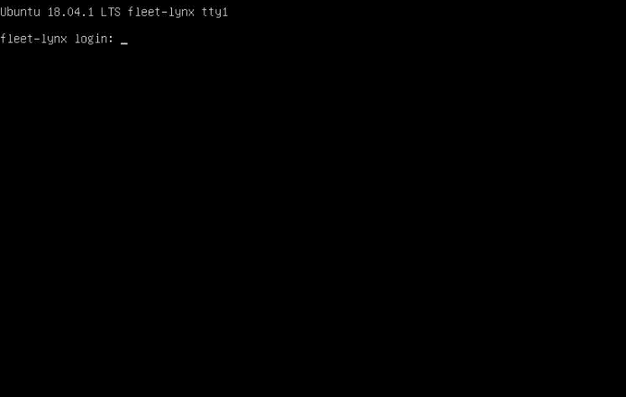

#8–3 OS Automatic Installation:Deployment (2/2)
<Complete Deploying (OS booted)>
Machine state is changed to
‘Deployed’
<Complete Deploying (On Web GUI)>

Slide 39
Review

Slide 40
Lab Summary
With Tower Lab, you have experimented selected roles of Monitor/Control (관제) Tower
Visibility Center function to enable ‘distributed monitoring’ over remote Boxes and to store ‘monitoring information’ to time-size DB.
Provisioning Center function to enable remote ‘installation & configuration (of OS and others)’ of distributed Boxes.

Slide 41
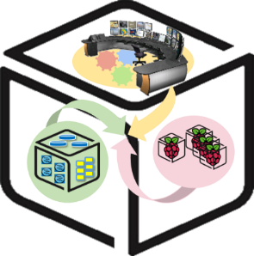
Thank You for Your Attention
Any Questions?
mini@smartx.kr

